Slide 1
Airbus Ship Detection Sprint 2
Team: | He Li (heli@bu.edu)
 | Ruxin Diao (ruxin@bu.edu)
GitHub: | https://github.com/helibu/Airbus-ship-detection
Trello: | https://trello.com/b/OI51Ynv6/airbus-ship-recongization

Slide 2
CONTENTS
Diagram of the product
Next Step
Trello page for Progress
EDA of Dataset
Deep learning Model
Results
Technology choice

Slide 3

Diagram of the product
Dataset
User Input image/dataset
Cloud (Kaggle for now)
Test data validate
Web page
Windows app
Web server (AWS)
TensorFlow
Training model
Cross validation
Applications
Model develop and optimize
Output the numbers and locations of ships
Notes:
The U-Net is a convolutional neural network for segments and classification. U-shaped architecture.
VGG16 is deep convolutional network for object recognition developed and trained by Oxford's renowned Visual Geometry Group. Very Deep Convolutional Networks for Large-Scale Image Recognition
ResNet is a residual learning framework, Residual neural networks do this by utilizing skip connections or short-cuts to jump over some layers

Slide 4
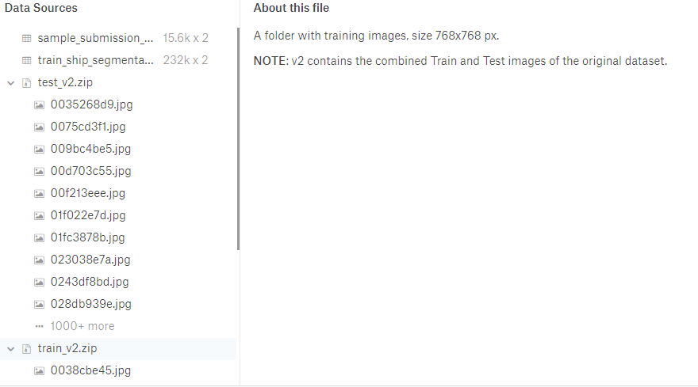
Exploratory Data Analyze (EDA)
What’s been given?
Train dataset:
Satellite images (768*768 = 589824) with segmentation information
Test dataset:
Just satellite images
What to give:
Segmentation information of the test data set
EDA git: https://github.com/helibu/Airbus-ship-detection/blob/master/ship%20detection%20data%20analysis.ipynb

Slide 5
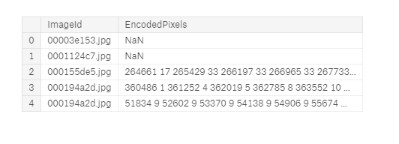
EDA
Platform: training model on Kaggle kernel
Segmentation information (Run-length encoding (RLE) )
As you can see, the EncodedPixels are the ship location in the images.
For example, total pixels are 768*768 = 589824, in pic 2, 264661 17 means, from 264661 pixel to 264678 pixel is ship. This is for training data only. What we need to feed back is something like this.
Also, NaN means no ship in the image.

Slide 6
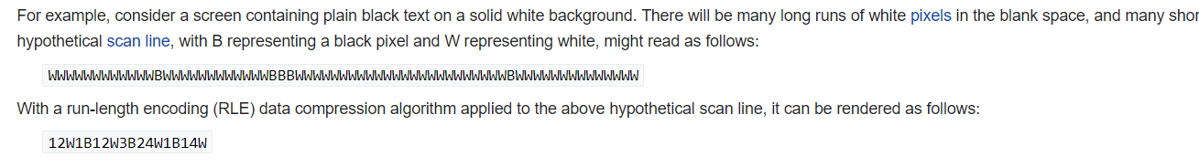
EDA
Run-length encoding (RLE) is a very simple form of lossless data compression in which runs of data (that is, sequences in which the same data value occurs in many consecutive data elements) are stored as a single data value and count, rather than as the original run.

Slide 7
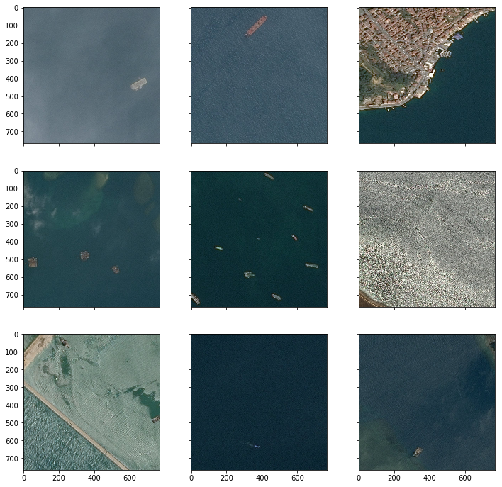
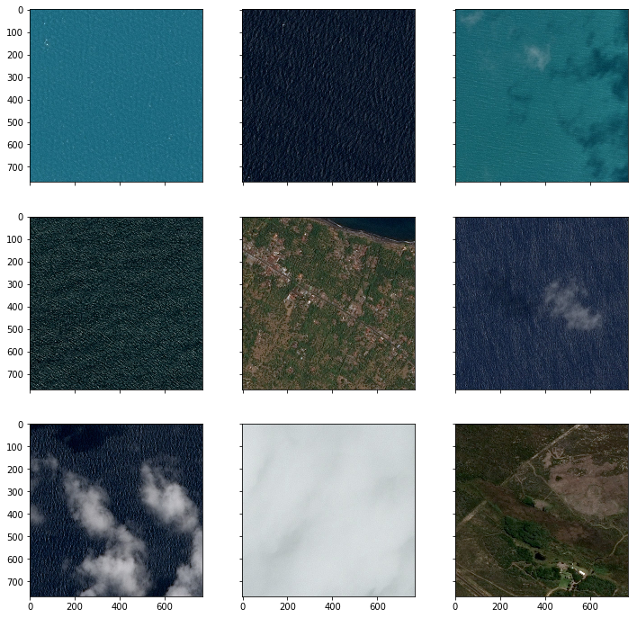
EDA
Based on segmentation information,
With ships Without ships (NaN)

Slide 8
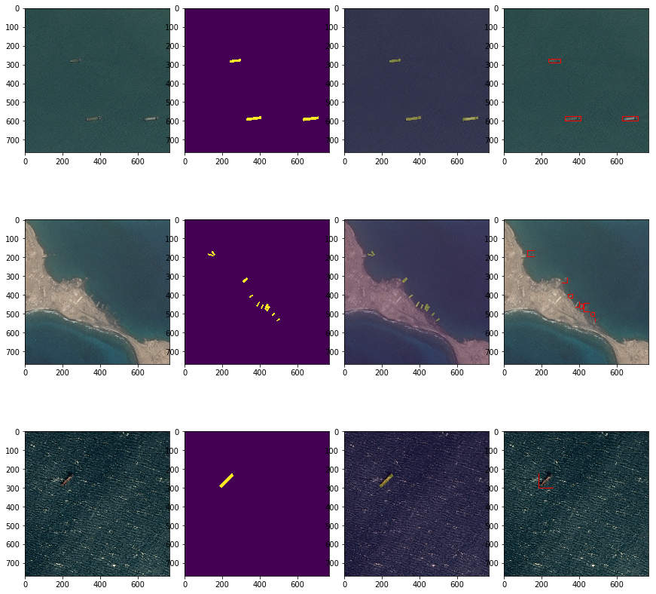
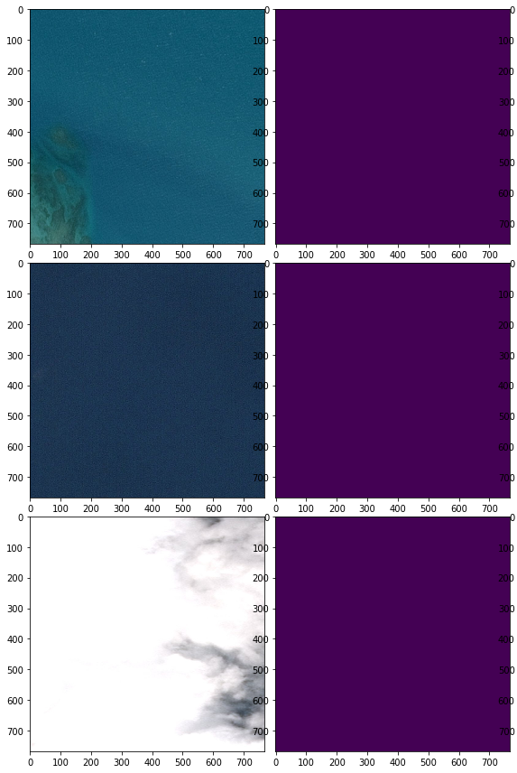
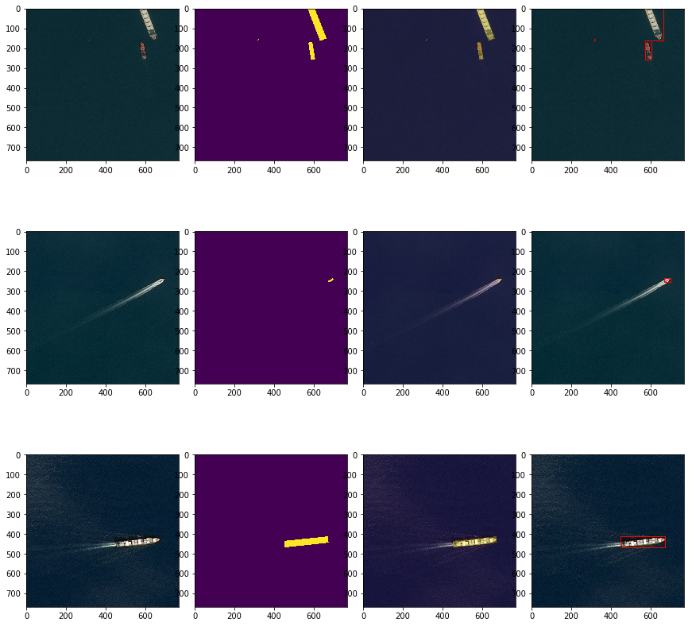
EDA
Apply the segmentation information as masks in the train dataset.
EncodedPixels with mask 1, other positions with mask 0
The third column is with transparent mask, the forth is with box border (use label, regionprops from skimage.measure lib)

Slide 9
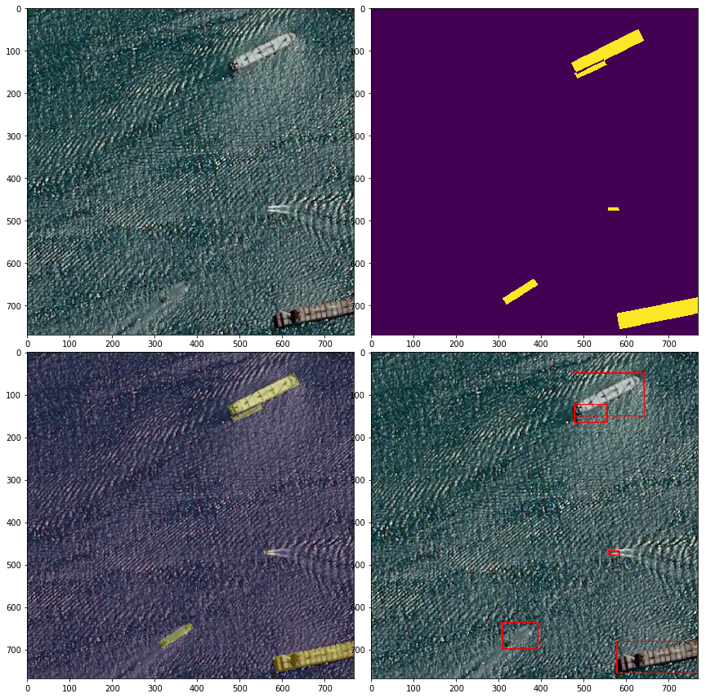
EDA
Origin
Mask
Transparent
Mask
Border
Box

Slide 10
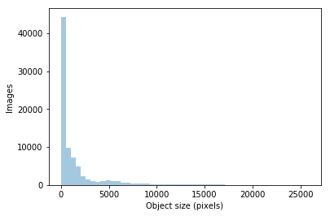
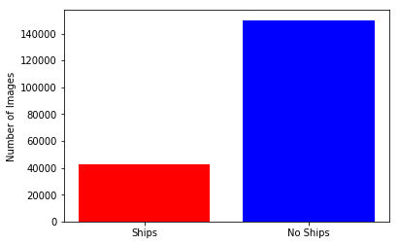
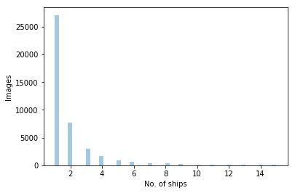
Exploratory Data Analyze (EDA)
EncodedPixels size distribution
From pixels distribution, pixels
are pretty small, so we need a
algorithm with high-resolution.
Ship numbers distribution

Slide 11
Technology Selection
Model Selection
CNN with tensorflow.keras (Doing)
U-net (high-resolution feature) with tensorflow.keras (To do)
U-net with dropout or other features (To do)
Model Training
Kaggle kernel (Using)
Google colab / Bu server (To do)
Web App
Frame: HTML, CSS, C#, python (Doing)
Database: MySQL (To do)
Web Server: AWS (To do)

Slide 12
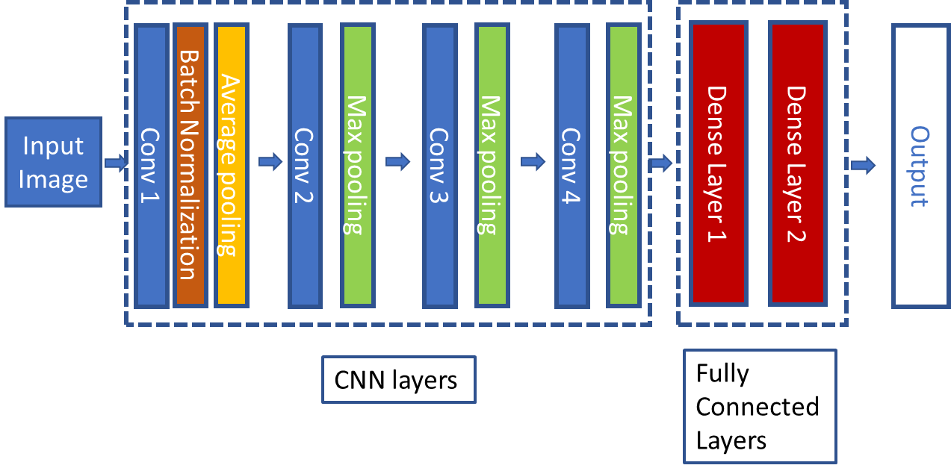
Deep learning model selection
Simple one: Basic CNN model with tf.keras
To detect whether there is a ship in the image or not (0/1) (finished)
To point out the number and position of ships (Doing)
Network Structure

Slide 13

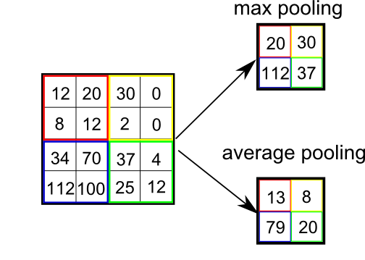
Deep learning model selection
Basic concepts:
1. Conv layer
2. Pooling layer
Source: https://medium.com/data-science-group-iitr/building-a-convolutional-neural-network-in-python-with-tensorflow-d251c3ca8117

Slide 14
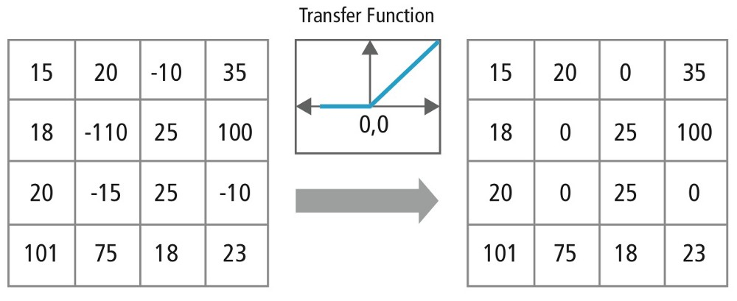

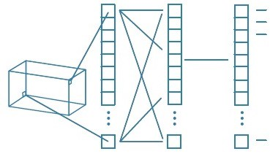
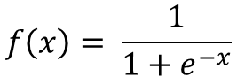
Deep learning model selection
3. Activation function
ReLU: Output = Max(zero, Input)
Sigmoid:
4. Fully Connected Layer
$$f\left(x\right)= \frac{1}{1+e^{−x}}$$

Slide 15
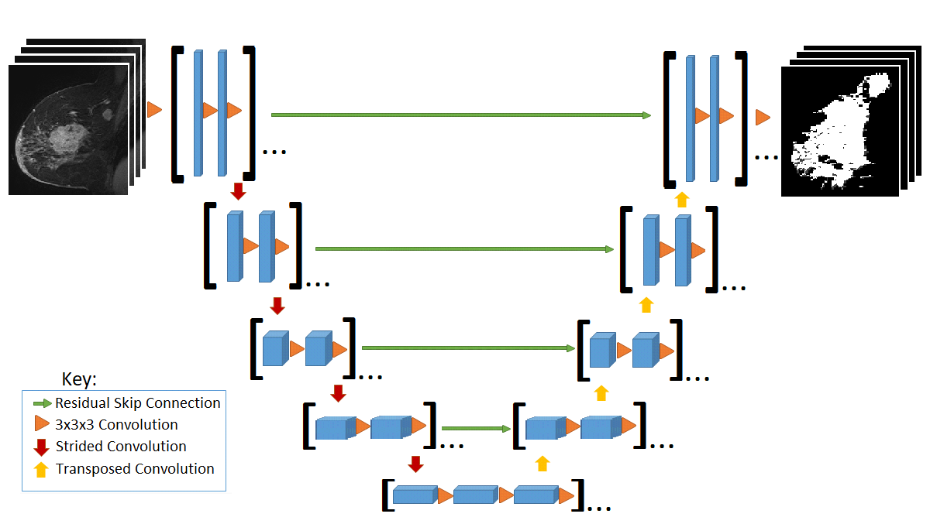
Deep learning model selection
Advanced one: Unet with tf.keras
Source:
https://www.kaggle.com/rackovic1994/convolutional-neural-network

Slide 16
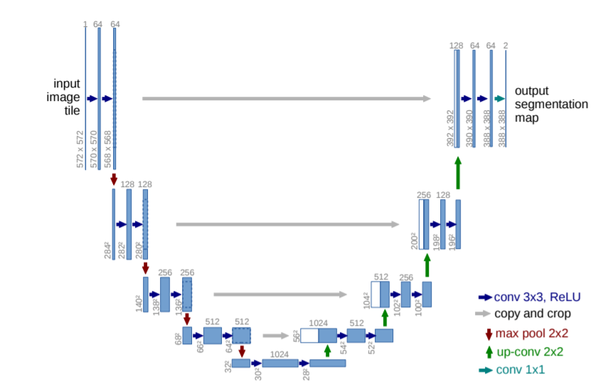
Deep learning model selection
What is U-net?
Contracting path
Normal CNN process
Expansive path
Combine CNN result from
features from up-conv and
high-resolution features from
contracting path
Why it is good in segment recognition?
With the high-resolution features in previous layers, the up-conv layer can assemble a more precise output. (Good for high-resolution images segmentations).
Source: “U-Net: Convolutional Networks for Biomedical Image Segmentation.”
Contracting path
Expansive path

Slide 17
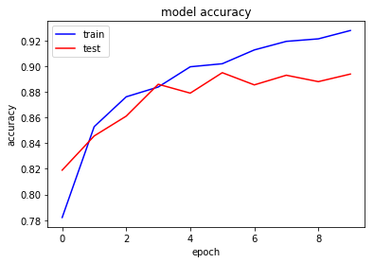
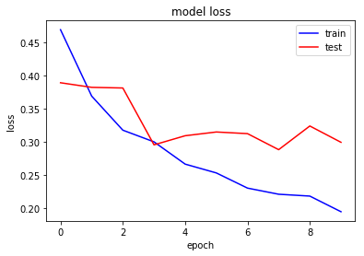
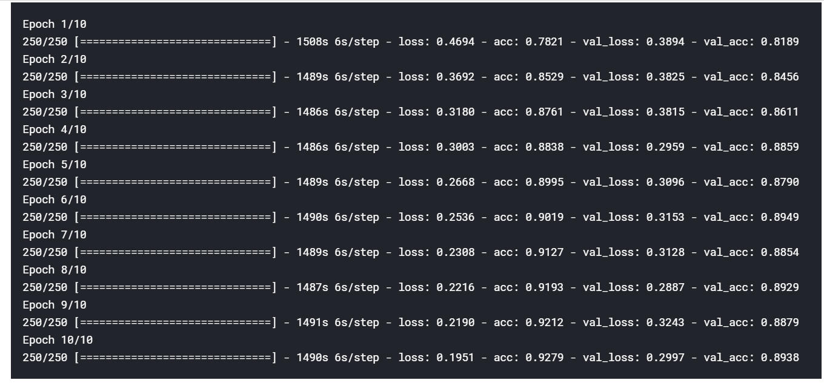
Results
Basic CNN model results
Split the training data to train and
test, train the model to predict the
existence of ships on the image.
Accuracy for training improved,
limited for test data.
Same for loss.
GitHub: https://github.com/helibu/Airbus-ship-detection/blob/master/Basic%20CNN%20model%20to%20detect%20ship%20existence.ipynb

Slide 18
Next step
He Li:
Basic CNN model ship location detection
Advanced U-net model development
Run on Google colab and BU server
Ruxin Diao:
Web database connection to MySQL
Web server plant on AWS

Slide 19

Trello Page

Slide 20
Thanks!

